Slide 1





TITLE: IMPLEMENTATION OF CURRENT TRENDS IN AI
Image Classification
GROUP MEMBERS:
PRATHMESH BATHAM-16010122014
KUNJ GOHIL-16010122060
AVNISHJOSHI-16010122073
RAAHI JOSHI-16010122075

Slide 2



PROBLEM DEFINITION
In today's digital world, the ability to automatically recognize and classify images has become crucial across various fields such as healthcare, automotive, security, and social media. The objective of this project is to develop an AI-based image classification system that allows users to upload an image and automatically predicts the category or label it belongs to. The system must be capable of handling variations in image quality, orientation, and background, and should deliver accurate and reliable predictions. By implementing this, we aim to demonstrate how machine learning models, particularly Convolutional Neural Networks (CNNs), can be used to automate the process of visual recognition and classification tasks efficiently.
02

Slide 3

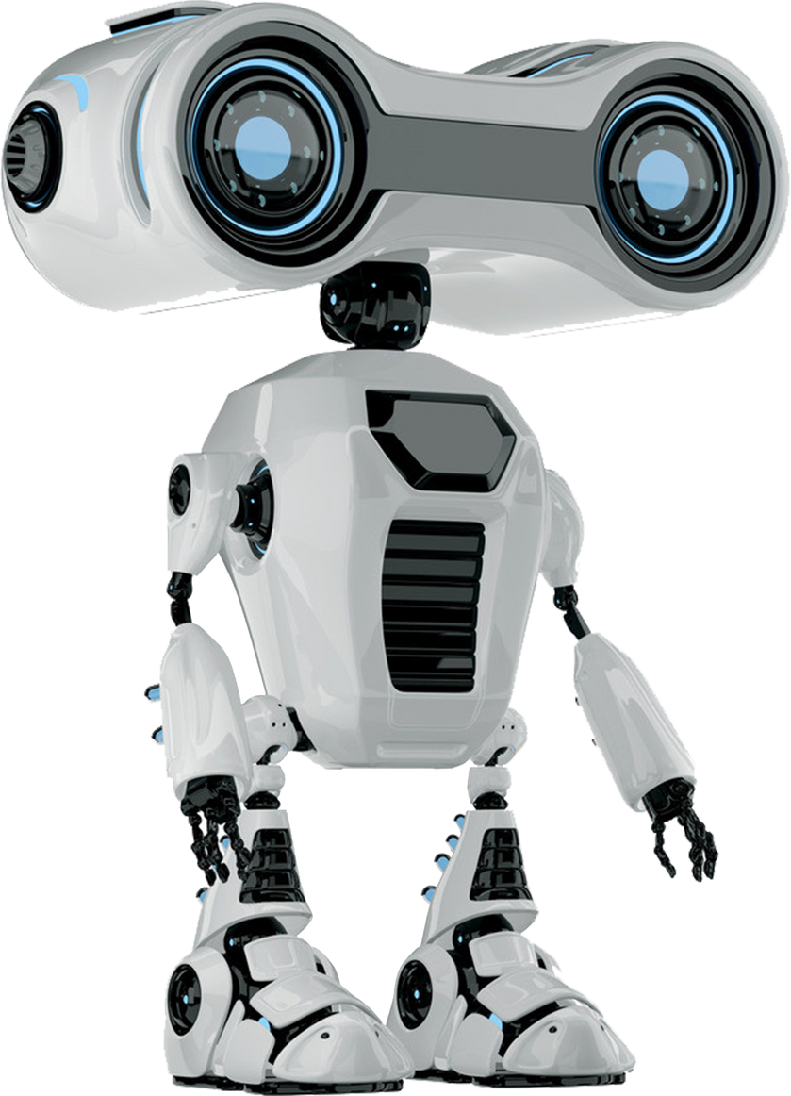
Objectives
Implement an image classification system.
Allow users to upload an image and receive a predicted label.
Use a standard dataset for training the model.
03

Slide 4
DATASET USED
Dataset Name: CIFAR-10
Source: Canadian Institute for Advanced Research (CIFAR)
Description: 60,000 color images of size 32x32 pixels
Classes: 10 categories (airplane, automobile, bird, cat, deer, dog, frog, horse, ship, truck)
Training Set: 50,000 images
Testing Set: 10,000 images
Purpose: Benchmark dataset for training machine learning and computer vision models
Link: https://www.cs.toronto.edu/~kriz/cifar.html
04

Slide 5
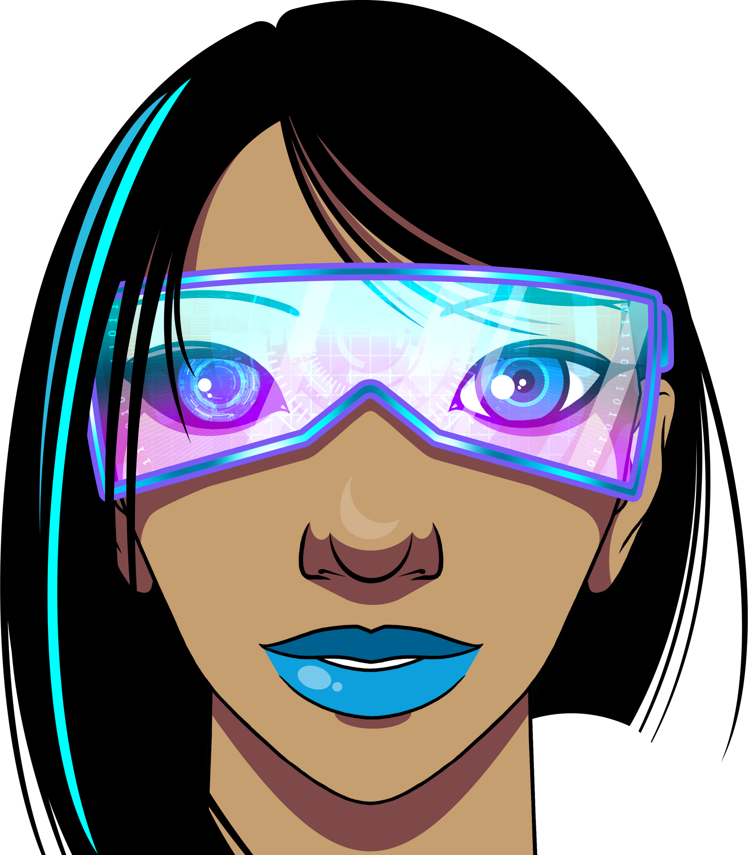
TOOLS, LIBRARIES, AND APIS USED
Programming Language: Python
Libraries:
TensorFlow / Keras
NumPy
Matplotlib
APIs:
None used
05

Slide 6
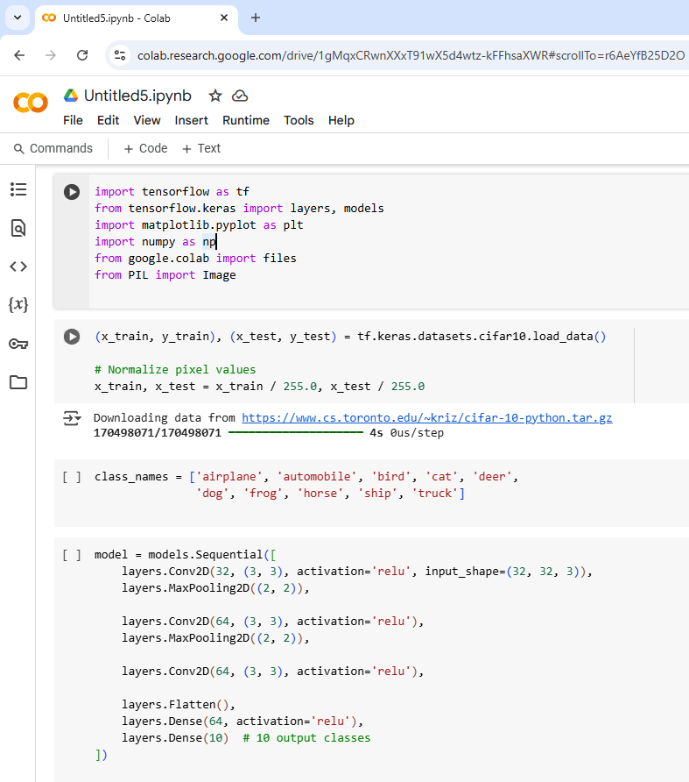
IMPLEMENTATION DETAILS
06

Slide 7
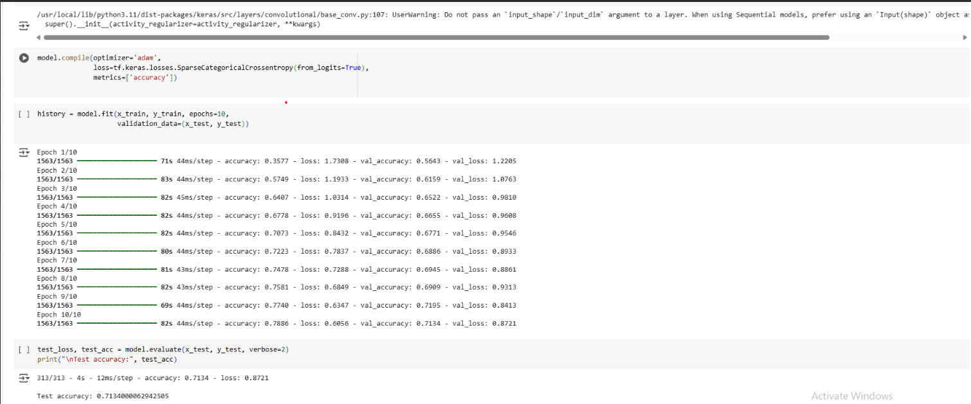

Slide 8
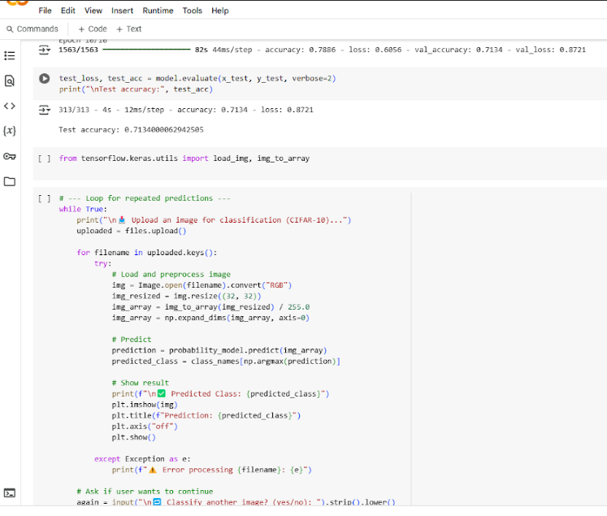

Slide 9
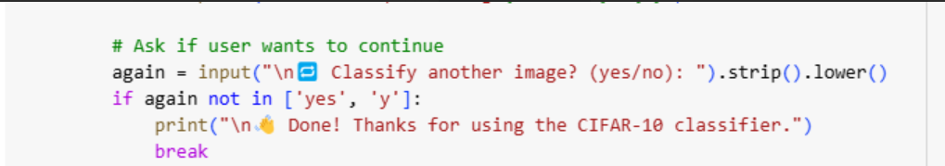

Slide 10
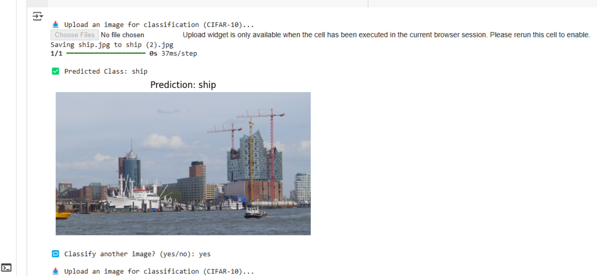
RESULT ANALYSIS
07

Slide 11
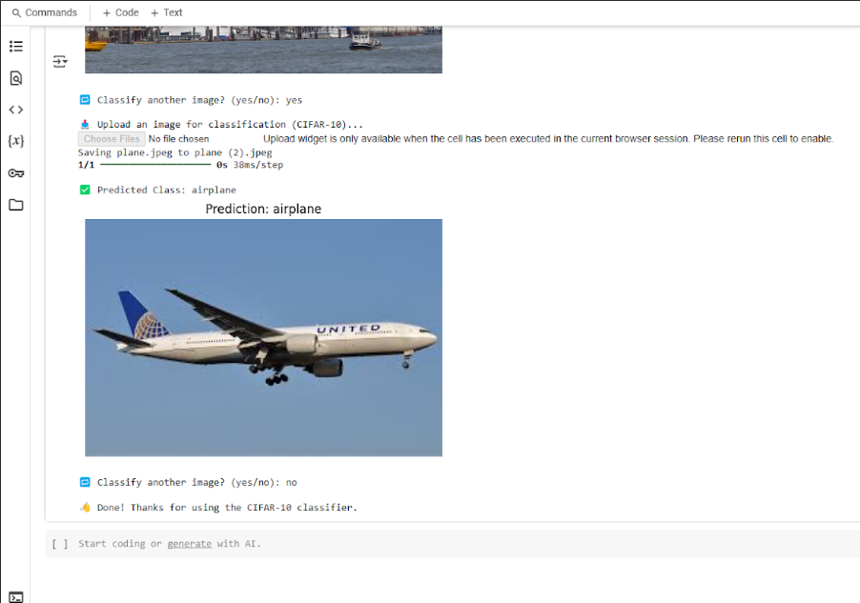

Slide 12
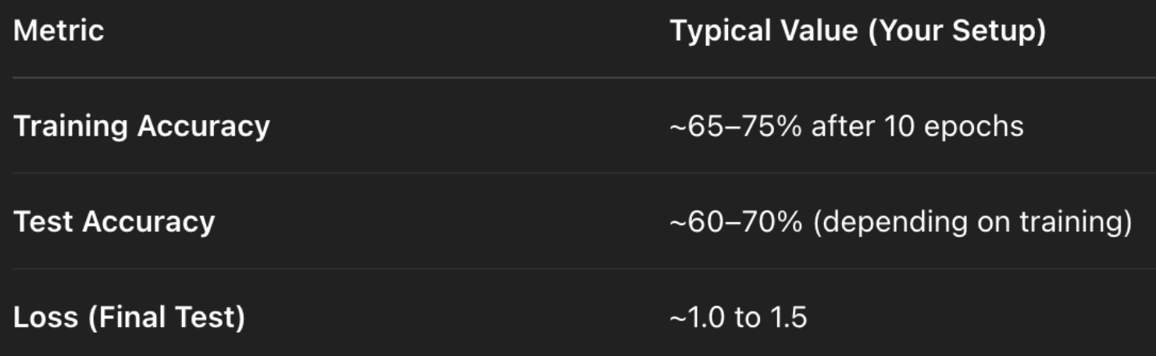

Slide 13

CONCLUSION
In this project, we built an image classification model that predicts the class of an uploaded image using the CIFAR-10 dataset. The system provides accurate results and demonstrates the practical use of AI in solving computer vision problems. It shows how machine learning can automate image recognition tasks across different fields.
08

Slide 14
Thank you

